Slide 1

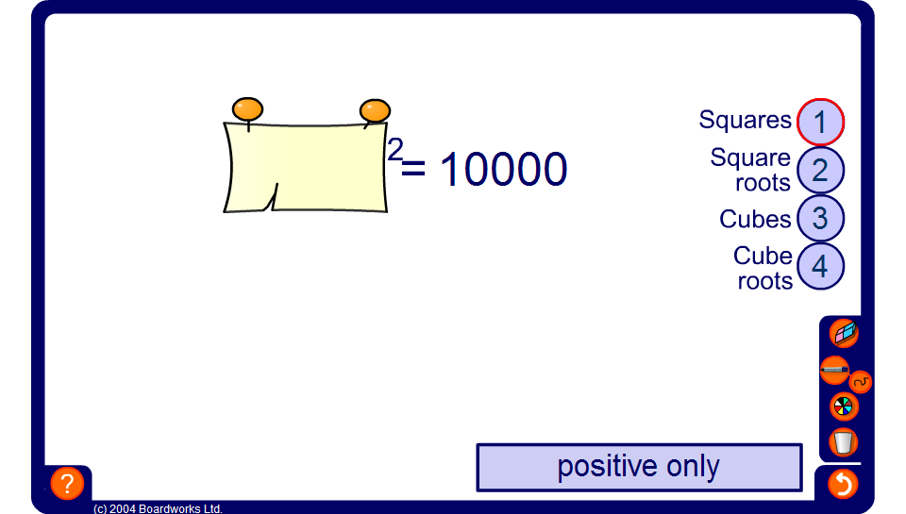


Squares, cubes and roots

